Slide 1
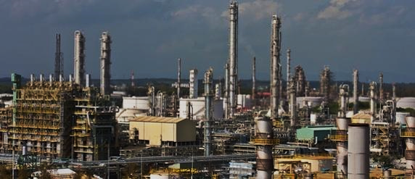
2019 AIChE SPRING NATIONAL MEETING Welcome to the 31ST Annual Ethylene Producers’ Conference MARCH 30 – APRIL 4, 2019 NEW ORLEANS, LA

Slide 2
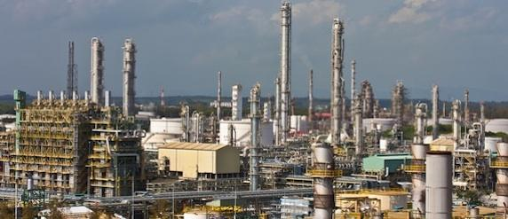
SESSION TITLE
(Session #)
Session Introduction
Name
Company
Name
Company

Slide 3
EPC Subcommittee Name Subcommittee
Last Name / First Name Company
Last Name / First Name Company
Last Name / First Name Company
Last Name / First Name Company
Last Name / First Name Company
Last Name / First Name Company
Last Name / First Name Company
Last Name / First Name Company
Last Name / First Name Company
Last Name / First Name Company
Last Name / First Name Company
Last Name / First Name Company
Last Name / First Name Company
Last Name / First Name Company
Provide contact information for participating on EPC subcommittee if interested!

Slide 4
Session Guidelines

Slide 5
Session Q&A and Surveys
New for 2019! – sli.do (“Slide-O”) is being used to submit questions and for gathering survey input.
Use cell phone to go to slido.com or download sli.do app from app store.
Code: AIChE
Select: 2019 Spring Meeting and 15th GCPS
Room: Select session by #/title of session you are in

Slide 6
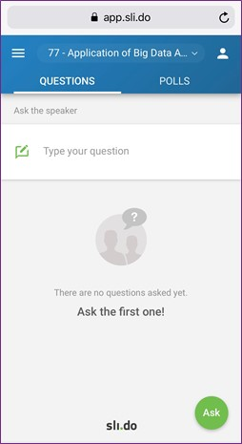
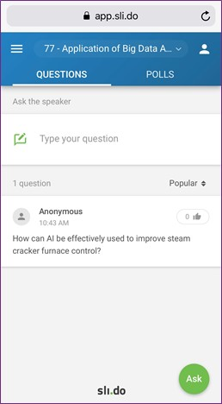
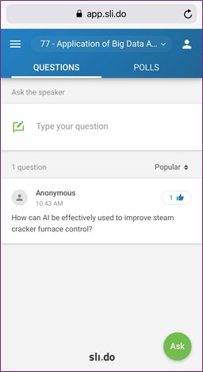
Session Q&A and Surveys
To enter question, go to “Questions” tab
Session #/title
Enter question and name (optional)
Questions tab
Vote for question by clicking here

Slide 7
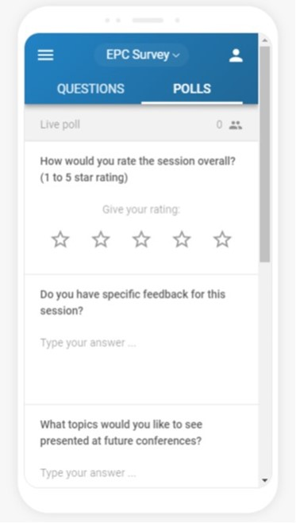
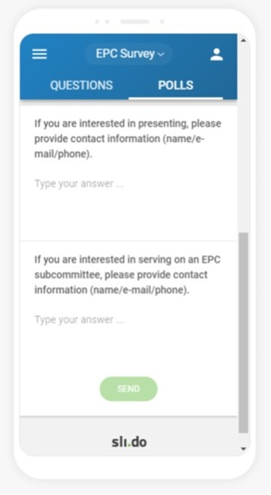
Session Q&A and Surveys
To complete survey, go to “Polls” tab
Complete five questions and click “Send”
Note: Survey is by session and not by paper
Opportunity to complete survey will be available entire day of session
Polls tab

Slide 8
Title (Session #)
Note: You can convert these bullet titles into hyperlinks to the presenters' PowerPoints by highlighting the paper no. and doing an <insert/hyperlink>. (delete this text box from your final presentation)
Welcome
Paper Title (Paper #)
Speaker, Company
Paper Title (Paper #)
Speaker, Company
Paper Title (Paper #)
Speaker, Company
Break
Note: Link “Break” to the Sponsor slide presentation. (delete this text box from your final presentation)

Slide 9
Title (Session #)
Paper Title (Paper #)
Speaker, Company
Paper Title (Paper #)
Speaker, Company
Paper Title (Paper #)
Speaker, Company
Closing Remarks

Slide 10
Title (Session #)
Please complete the session surveys (Polls) on sli.do
Reminders
slido.com or sli.do app
Code: AIChE
Select: 2019 Spring Meeting and 15th GCPS
Room: Choose session
Provide contact information for participating on EPC subcommittee if interested!

Slide 11
EPC Proceedings Website
Current proceedings will be posted a few weeks after the conference
Previous conference proceedings are available now
Many of your companies already subscribe and others are welcome to join
The above link is also available through the EPC Website
http://epc.omnibooksonline.com
https://www.aiche.org/epc

