Slide 1
The TurboPy Approach to Learning Python Presented to: The Virtual Local Section of the American Institute of Chemical Engineers
Paul Adamson
Pulsed Power Physics Branch, U.S. Naval Research Laboratory
July 27, 2022
DISTRIBUTION STATEMENT A. Approved for public release. Distribution is unlimited.
Work Supported by the US Naval Research Laboratory Base Program.
Notes:
Good afternoon, I’m Paul Adamson, a researcher at the Naval Research Lab in Washington DC, and I’ve got a brief talk about our virtual internship that we ran last summer mostly centered around an open source software package under development in our group, turboPy, and our plans to expand upon its success this coming summer. I’ve only got 8 slides because I wanted to leave plenty of time for a good discussion during and after the talk, so please put your comment or question in the Q&A box.

Slide 2
Genesis of a 100% remote, mostly asynchronous internship
By April 2020, it was clear that interns (and most of the staff) would not be on-site at the lab over the summer
Despite challenges due to the pandemic, there was a strong desire in NRL Pulsed Power Physics Branch (Code 6770) to continue internships
Energizes staff
Excellent recruitment tool
Service to nation/community
Fortunately, we had a new, lightweight Python framework for computational physics, turboPy, that was accessible to high school/undergrad interns
Also, turboPy was lacking robust documentation and testing, so we saw an opportunity to run an internship with some interesting goals:
Experience with end-to-end software development for scientific computing
100% turboPy documentation/testing
6x high school interns, 3x staff mentors + 1 student mentor
Sponsors very supportive
Source of fresh ideas and perspectives
We get some good work done!

Slide 3
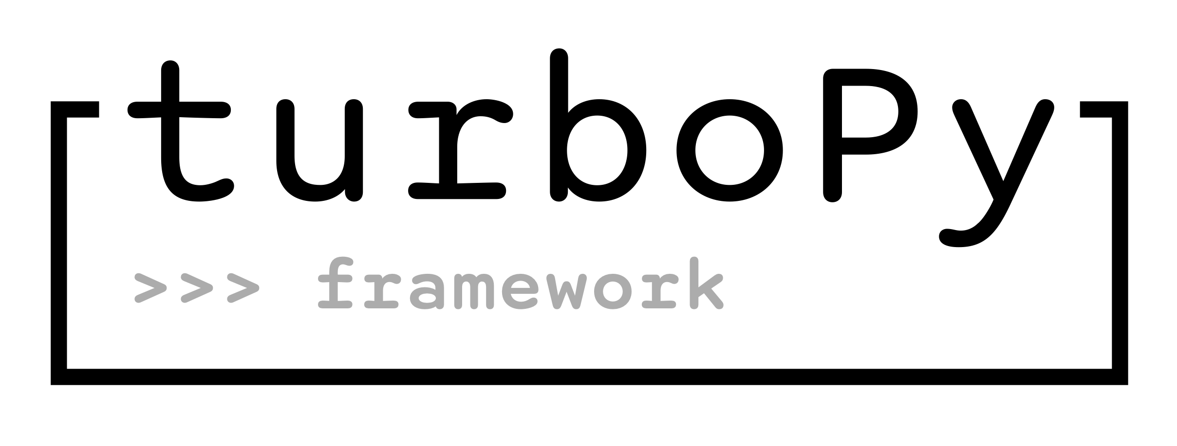
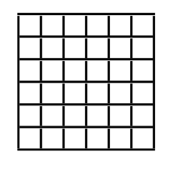
A lightweight python framework for computational physics
For physics problems with many possible model reductions, we need a way to quickly implement and compare options
We designed a lightweight framework to take care of common issues (grid, clock, diagnostics, data sharing between modules)
The framework will allow for a quicker implementation, testing, debugging, and evaluation cycle.
Encourages better programming practices via natural separation of responsibility in modules
Framework is based on the NRL PIC code turboWAVE, so there is a natural path to further develop promising models
Simulation
Diagnostic List
Grid
Clock
Diagnostic
Can access Module data
Is called every time step, or every N steps
Can write to file, cache for later, update plots, etc.
Can halt the simulation if conditions require
Diagnostic 2
⋮
Functions
Parses inputs
Initializes Modules, Diagnostics, and ComputeTools
Drives main simulation loop
Module List
Module
Owns data on the grid
Shares data
Updates data at each time step
Can use ComputeTool for specific algorithm implementation
Module 2
⋮
ComputeTool List
ComputeTool
Implementation of numerical algorithm
ComputeTool 2
⋮
https://github.com/NRL-Plasma-Physics-Division/turbopy
Notes:
- Since there are so many options for modeling all the various physics components that go into modeling plasmas, and we need a way to quickly implement and compare various models
- We choose python because of the robust tooling and community devoted to python developers, and the growing ecosystem around plasma physics and other disciplines
- We designed a lightweight framework to take care of common issues (grid, clock, diagnostics, data sharing between modules)
- Framework is based on the NRL PIC code turboWAVE written in C++, so there is a natural path to further develop promising models and algorithms
- Simulations are specified either directly in python or via optional TOML formatted input file

Slide 4
TurboPy Bootcamp Approach
Can run continuously throughout the year
Bootcamp & app incubator during the summer
Soft start/stop but defined bootcamp schedule
Some students work part-time outside summer
Asynchronous with seminars & office hours
Two overlapping “phases”
Bootcamp: git, python, testing, documentation, continuous integration
App incubator:
NRL apps (turboPy, TurboWAVE, nepc, etc)
M&S, data analysis (mostly public & private GitHub repos, some behind the firewall)
RealPython.com, other resources as needed
GitHub for asynchronous communication, project management, and code management
Microsoft Teams for seminars, office hours, and pop-up meetings
Interns have ownership of internship
Rotating roles: “Intern Admin,” “Project Manager,” returning interns help run it
“turbopy boot camp” git repo to manage training
See https://github.com/NRL-Plasma-Physics-Division/turbopy-training-public for released version of curriculum from 2020
https://github.com/NRL-Plasma-Physics-Division/nfe-2022-turbopy for latest version
Periodic media highlights and other publications
Continuous Integration (CI) reinforced throughout: issue/comment – clone/branch – test – code – retest – PR/comment – merge
Notes:
Mentors set the schedule, establish goals for seminars, and facilitate discussions.
Interns contribute notes to lesson markdown files.
Intern admin role gives interns experience managing a code repo for open source projects.
Project manager role gives interns experience managing people.
turbopy-training repo used to manage the training, seminars, and reflections.

Slide 5
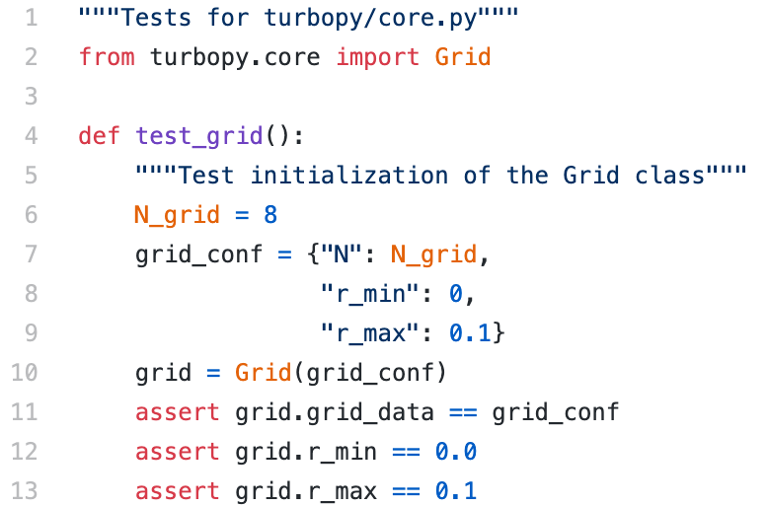
2020 Successes
Intern contributions to turboPy “core”
turboPy “core”: 42 commits 2047 ++ 381 –
Virtually no testing → almost full code coverage
Including two integration tests (“turboPy apps”)
Full documentation
Continuous Integration
Two turboPy apps
https://github.com/NRL-Plasma-Physics-Division/particle-in-field
https://github.com/NRL-Plasma-Physics-Division/block-on-spring
Many interns stayed on after the summer ended; positive engagement through issue “bidding”
Interns contributed to published paper on turboPy
https://doi.org/10.1016/j.cpc.2020.107607
From one simple example test…
To virtually complete test coverage…
tests/test_bos.py ... [ 5%]
tests/test_computetools.py ................... [ 40%]
tests/test_core.py [ 98%]
tests/test_pif.py . .......................... [ 87%]
tests/test_diagnostics.py ...... [100%]
5

Slide 6
2021 Expansion and Steady-State
Many recognize “turboPy Internship,” and it’s catchy, so it’s our brand
ONR funded expansion of the Python boot camp and app incubator in 2021
NRL Code 6770 interns completed several projects within turboPy
Expanded apps to other NRL open source codes (e.g. nepc)
Current curriculum available on GitHub for 2022 Naval Research Enterprise Internship Program (NREIP) Fall Engagement (nfe-2022-turbopy)
Feel free to fork/clone nfe-2022-turbopy, ask questions (via issues), or even make pull requests (PRs) if you find errors or a better approach
https://github.com/USNavalResearchLaboratory/nepc
https://github.com/NRL-Plasma-Physics-Division/nfe-2022-turbopy

Slide 7
TurboPy Bootcamp Curriculum Walkthrough and Demonstration
https://github.com/NRL-Plasma-Physics-Division/nfe-2022-turbopy

