Slide 1
Becoming a Chemical Engineer
Why, What and How
(Jason) Zhenyu Huang, PhD
AIChE Apprentice Program
January15 2013

Slide 2
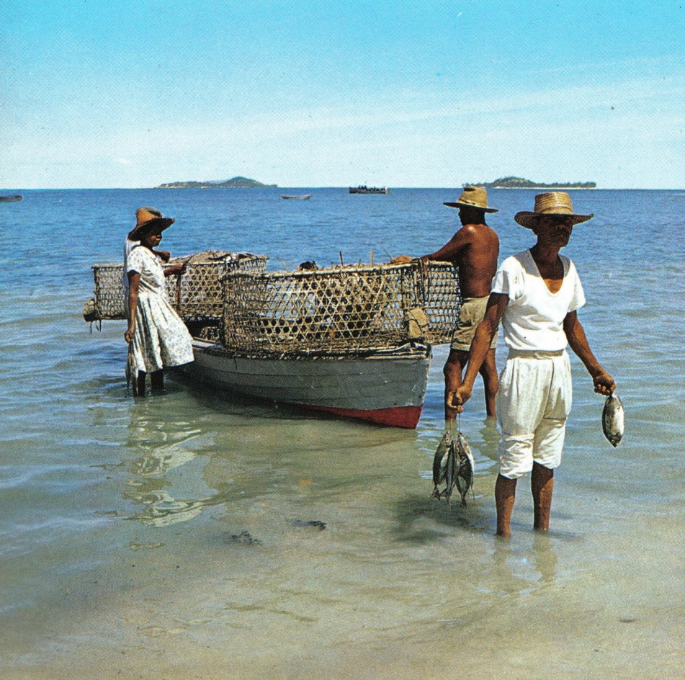

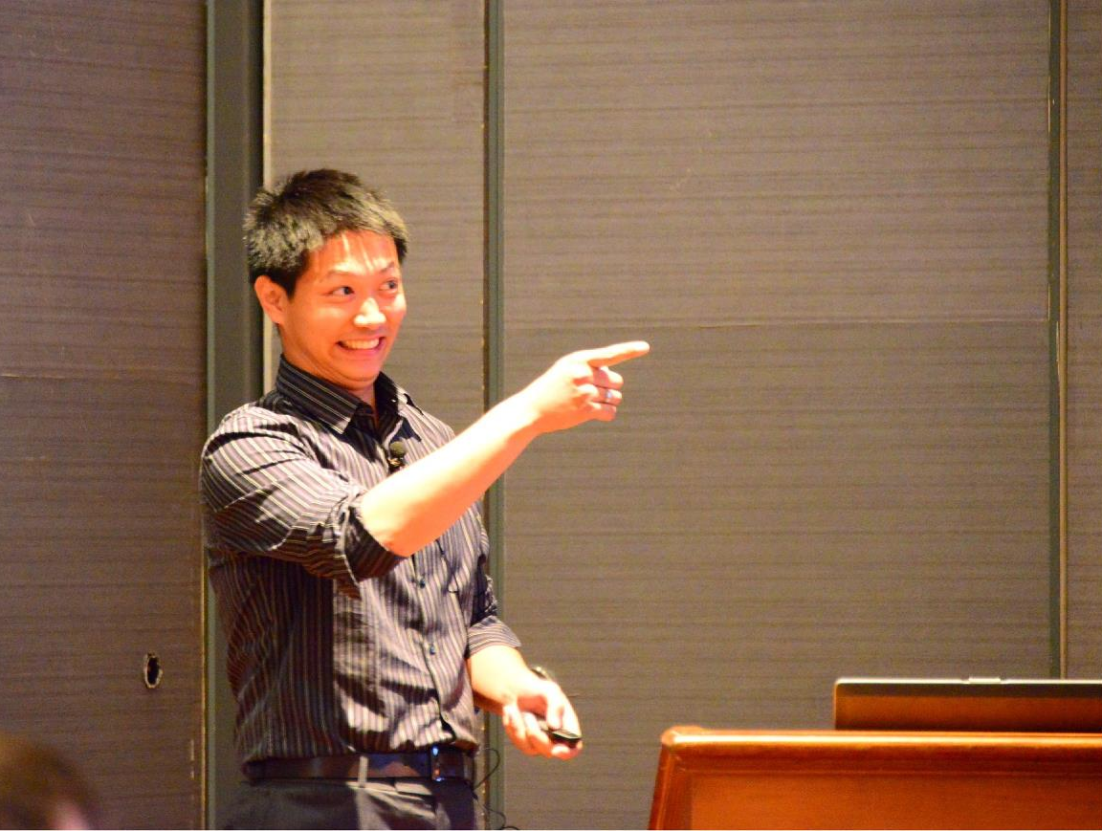

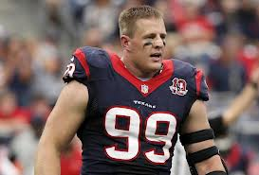

Who is Jason Huang???
1984: Grew up in a small town near HongKong, China
2002: Scored top 0.3% in Chinese National College Entrance Exam, one point over the admission line of Tsinghua University (China)
2006: Admitted by University of Michigan, Chemical Engineering
2011: Completed PhD
2012: Started career in Houston as an engineering consultant
International awards, academic journal/book publications and conference presentations
1/14/2013: Presenter at Cinco Ranch High School

Slide 3

Why is He Here???
American Institute of Chemical Engineers (AIChE) – Apprentice Program
To share with high school students some of my thoughts on chemical engineering
Houston local high schools
Collect feedback from students

Slide 4
Presentation Outline
Becoming a Chemical Engineer
Why would I want to be a chemical engineer?
What can a chemical engineer do?
How do I become a chemical engineer?

Slide 5
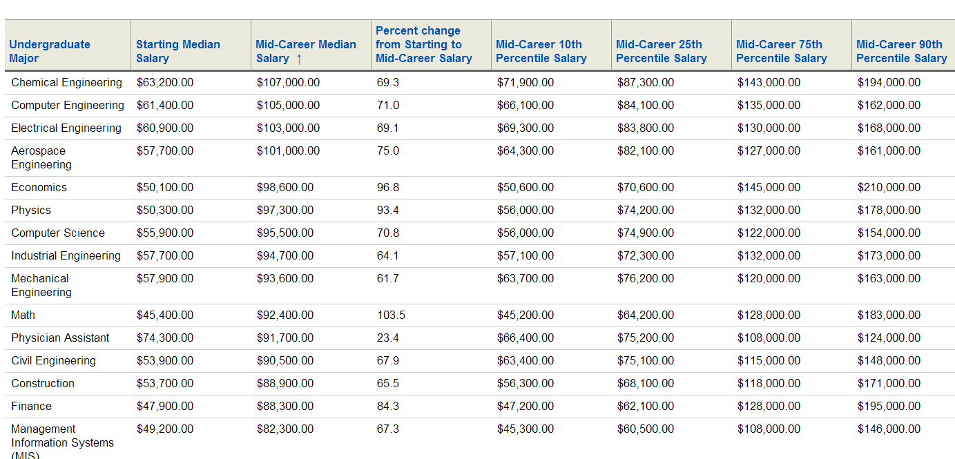
Why Would I Want a Chemical Engineering Degree?
$$$
Good job security
A variety of career options
  Industry
  Academic
  Medical School
  MBA
  Law School
Jason’s biased view
  To help create a better community
  A way to buy mommy a new car
  An opportunity to put my intelligence on high gear
  A way to show my high school classmates that the geekiest might be the first one to buy a house
http://online.wsj.com/public/resources/documents/info-Degrees_that_Pay_you_Back-sort.html#top

Slide 6
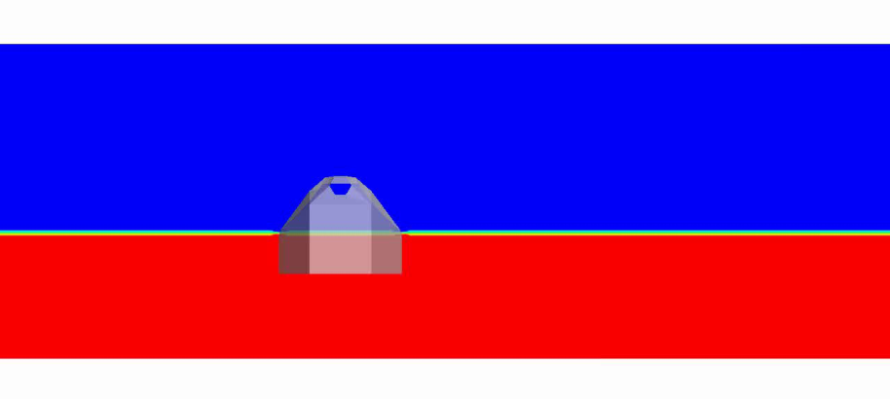
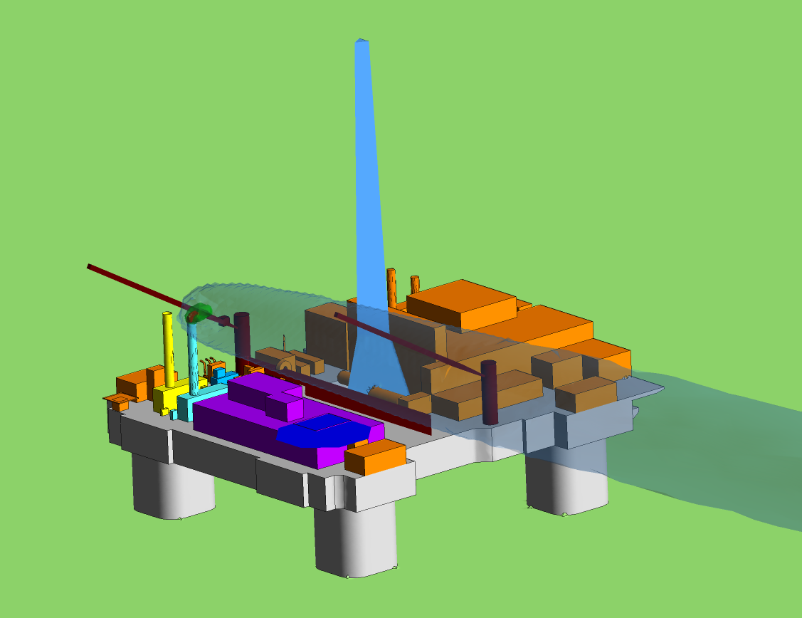
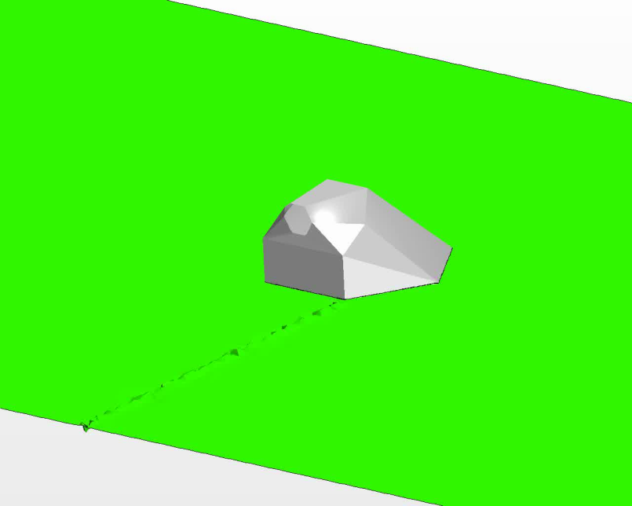
What Can Chemical Engineers Do???
Petroleum Industry
  Design and assure the best operating scenarios
Designing wind turbines for energy generation
Designing oil platforms for safe operations

Slide 7
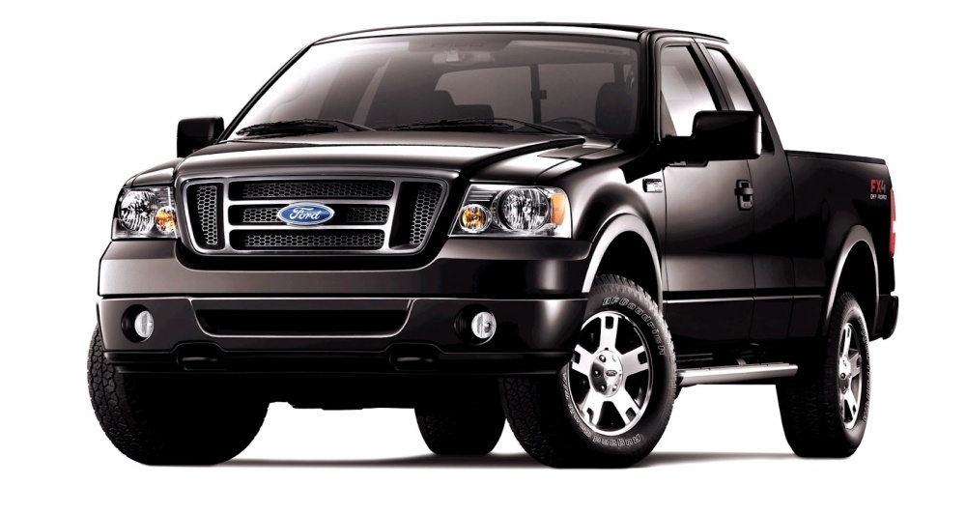
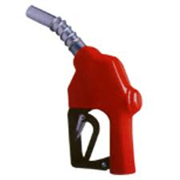
What Can Chemical Engineers Do???
Catalyst Design
  Reduce undesired emissions by motor vehicles
Air
CO₂ , H₂O
Normal Desired Temperature
CeO₂
CO, NO_{X}, etc
Temperature Too High
http://www.bearriverconverters.com/data/CatOpp.pdf

Slide 8
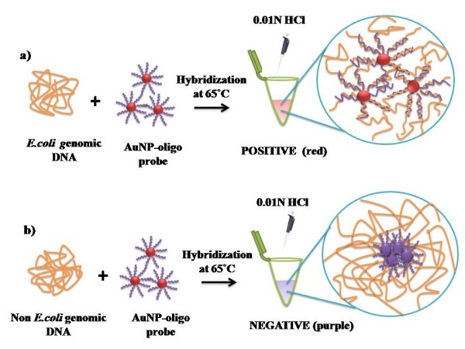
What Can Chemical Engineers Do???
Nanotechnology
  Medical Applications
    DNA/Protein Detections

Slide 9
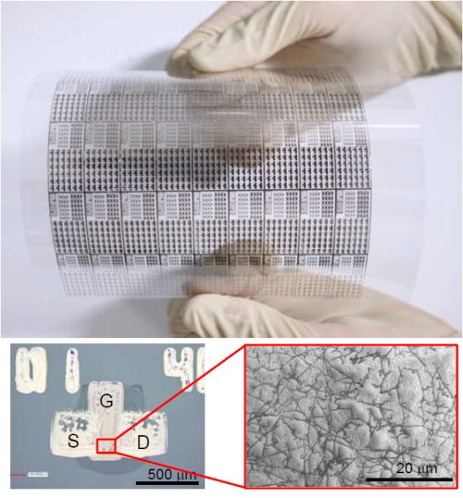
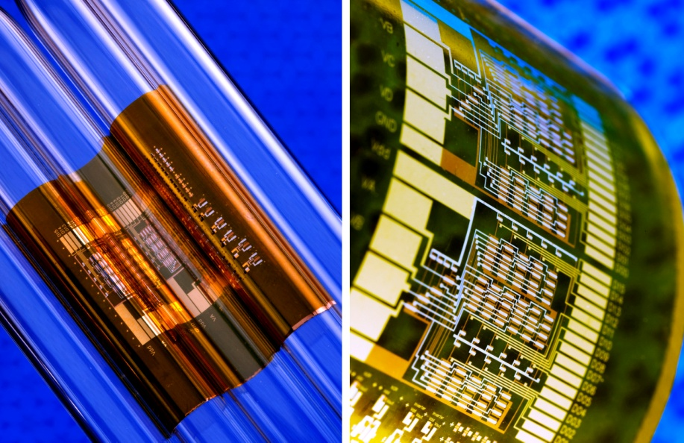
What Can Chemical Engineers Do???
Traditional Display Material (Indium Tin Oxide)
Nanotechnology
  Material Science
    Design devices with unprecedented features
Glass Support
Carbon Nanotubes
Plastic Support
http://www.dummies.com/how-to/content/nanotechnology-can-make-computer-displays-lightwei.html
http://www.dailytech.com/Carbon+Nanotubes+Now+Promising+Better+Flexible+Displays+Circuits/article12492.htm

Slide 10
Chemical Engineers =/= Chemists
Chemists
  Identify potential solutions
Air
CO₂ , H₂O
Normal Desired Temperature
CeO₂
CO, NO_{X}, etc
Temperature Too High
Chemical Engineers
  For given engine size, fuel type, rate of fuel/air flow… etc, how much of the fuel goes to CO₂ and H₂O and how much of it goes to CO and NO_{X}?
  How is the best design parameters for a F150?
The reward can be different as well…

Slide 11
What are the Career Paths for Chemical Engineers?
Research Institutions/Universities
Pharmaceutical Firms
Hospitals
Chemical Manufacturers
Chemical Engineers
Petroleum Companies
Food Manufacturers
Research and Development
Consultant
Process/Project Engineer
Sales/Marketing
Government Agencies
Consumer Products Firms
Consulting Firms
(Engineering/ Environmental / Financial)
Nuclear Plants

Slide 12
What Should Chemical Engineers Learn???
Air
CO₂ , H₂O
Normal Desired Temperature
CeO₂
CO, NO_{X}, etc
Temperature Too High
What it takes to become a chemical engineer
  High School
    Chemistry, Physics, Math, Biology and Computer Science
  College/University
    Fluid/solid mechanics
    Reaction Engineering
    Heat and mass transfer
    etc
“Instead of weekend bar-crawlers, Grad schools and companies actually look for thinkers and problem solvers.”

Slide 13

Qualities of a Successful Chemical Engineer
There might not be an universally-agreed definition of “successful chemical engineer”
Some of my thoughts:
  Pro-activity (always go a step beyond)
  Result: a shorter learning/growing curve
`
What are the most popular dishes?
Where is food purchased?
How much is the rent?

Slide 14


Qualities of a Outstanding Chemical Engineer
There is hardly an universal definition of “outstanding”
Some of my thoughts:
  Pro-activity (always go a step beyond)
  Critical thinking (“why is that?”)
“Vicious, violent video games. We have blood-soaked films. Our nation's refusal to create an active national database of the mentally ill”
“Clearly, the reason we have more gun deaths than anyone else in the industrialized world isn't the guns. It has to be that America is the only country in the world that has video games. We're the only country that has violent movies, and we're the only country with crazy people.

Slide 15
Qualities of a Successful Chemical Engineer
There is hardly an universal definition of “success”
Some of my thoughts:
  Pro-activity (always go a step beyond)
  Critical thinking (why is that?)
  Presentation/communication skills
  Teamwork & leadership skills
    Why
      It might suck when everyone hates you
      Bosses usually earn more
    How
      Team member: Understand that you have to learn from others in order to become a leader)
      Team leader: Understand that you will need others to complete the task
    Be confident! It is much less difficult than chemical engineering☺

Slide 16
Thank You!

